Slide 1
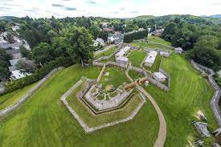
Forts on the Frontier
How they were designed
In 1758

Slide 2
Why were Forts Built?
Forts were built for three (3) reasons:
To protect important places such as roads, towns, and borders,
To serve as supply depots, or “magazines”, for food and supplies needed by the army, and
To provide a place of safety in times of trouble.

Slide 3
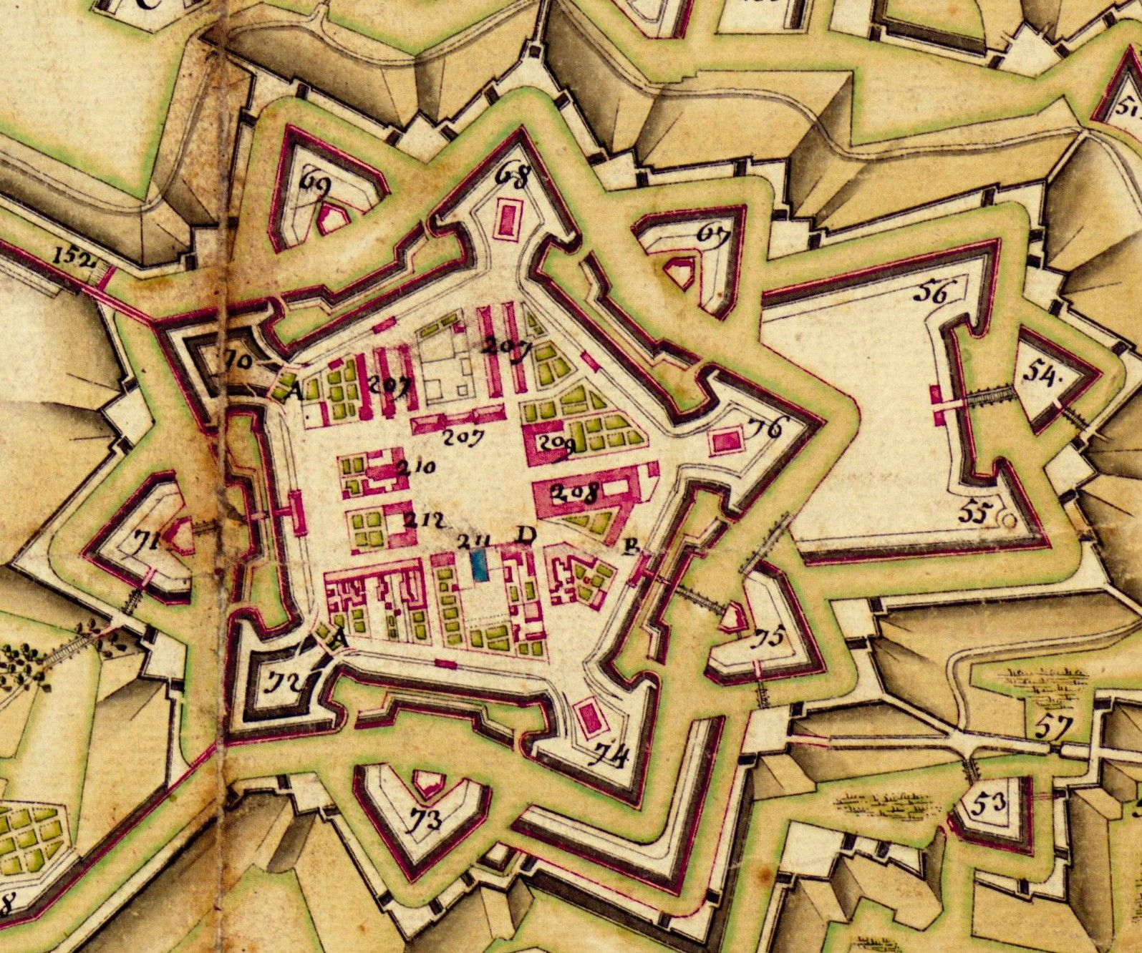
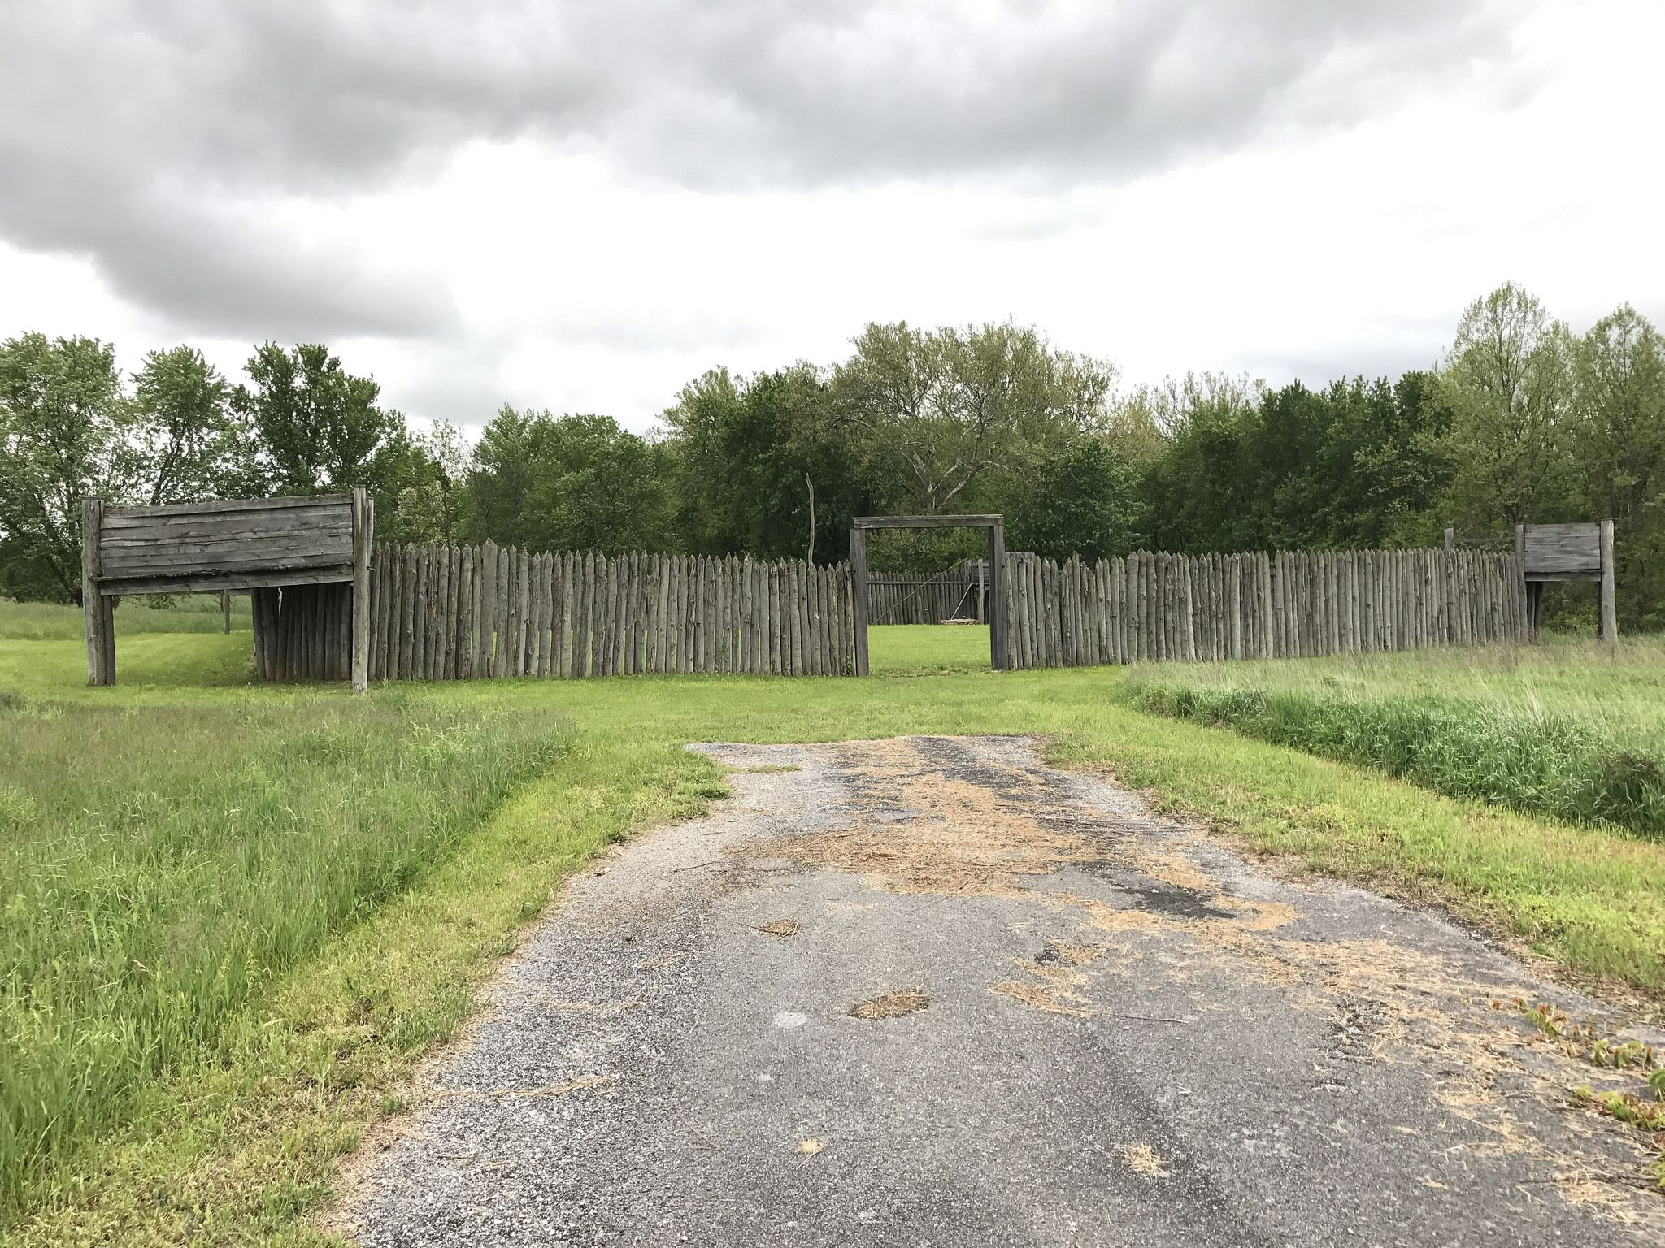
Forts could be very elaborate or simple in design
Elaborate
Simple

Slide 4
All Forts used three (3) simple forms or shapes in their design
Squares or Rectangles
Lines
Angles
These shapes could be combined in many ways to form different types of forts.

Slide 5
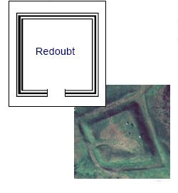
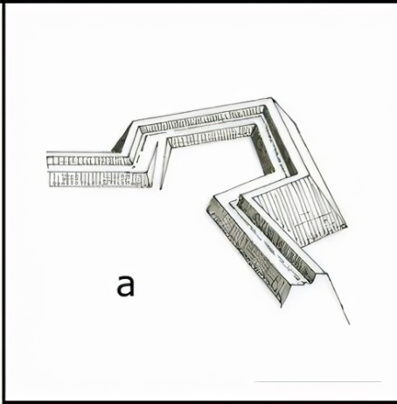
Squares and Rectangles
A very simple fort could be made as a square or rectangle
A simple square or rectangular fort was referred to as a REDOUBT
Often a REDOUBT would be built near a larger fort to provide additional protection
Square structures were built at the corners of forts, and these were referred to as BASTIONS

Slide 6
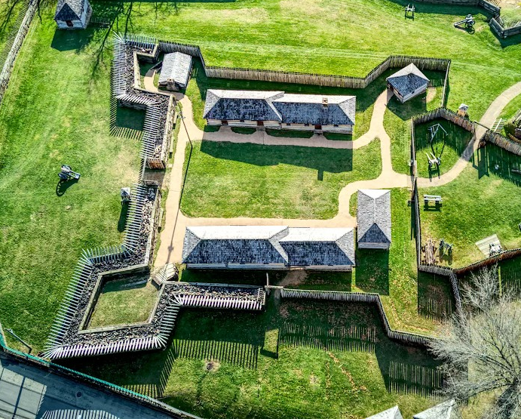
Lines and Walls
Lines were straight walls connecting two parts of the fort
Lines were used to connect BASTIONS, and these lines were called CURTAIN WALLS. At Ft. Ligonier, the straight walls connecting the bastions are the curtain walls.

Slide 7
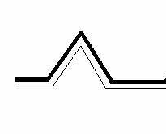
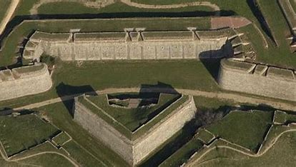
Angles
Angles were used to provide additional structures to provide protection for the fort’s occupants
Angles could be built into curtain walls. This type of angle structure was called a REDAN
Angles could be free standing structures, like redoubts, and placed in front of weak areas such as gates.
These type of angle structures were called RAVELINS

Slide 8
Steps in Building a Fort
1. The Engineer would mark out the outline of the fort on the ground using stakes and rope;
2. Soldiers would begin digging the “dry moat” or “trench” in front of fort walls;
3. The earth from the dry moat would form the foundation of the fort wall, which was called the RAMPART. More earth from the dry moat would be placed on top of the rampart to make the PARAPET, which protected the soldiers from enemy bullets;
4. RAVELINS were built in front of gates; and
5. REDOUBTS were often built at the same time as the main fort.

Slide 9
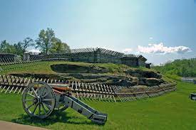
Good luck!
"Knowledge is in every country the surest basis of public happiness.”
- George Washington

